Slide 1

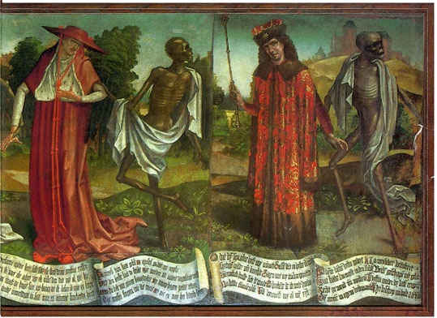
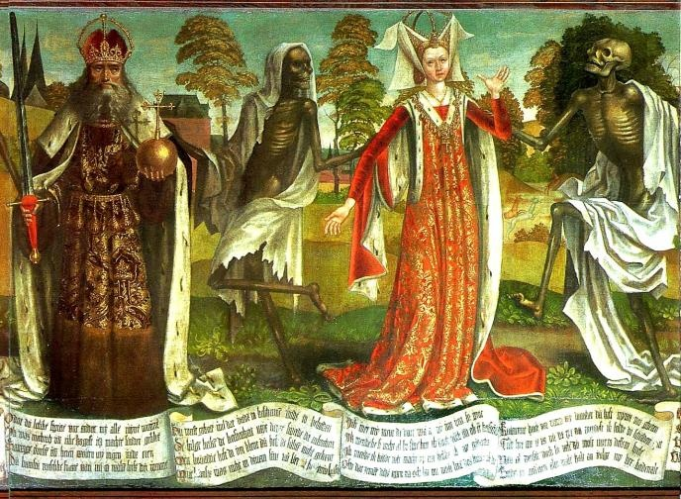
Connect
What was the most significant effect of the Black Death?
Listen to the song and read the lyrics. Circle all the different people that are affected by death?
Is there any escape from it?
Ext:
Look at the art work here.
Can you guess who the people in the painting are?
EXT: Is there any escape from it?
 | Come to a personal and supported conclusion on the most significant impact
 | Explain the impact each effect had on the people
 | Identify 3 effects of the Black Death
Notes:
What does that word mean, why did you pick it, how does it make you feel?

Slide 2
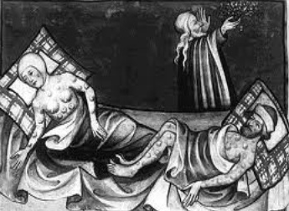
Connect
What was the most significant effect of the Black Death?
Turn to the person next to you and tell them 3 things about the Black Death:
 | 1 thing people thought caused it?
 | 1 thing people thought cured it?
 | 1 Symptom of the Black Death?
EXT:
Is there any way the plague/ Black Death could be a good thing?

Slide 3


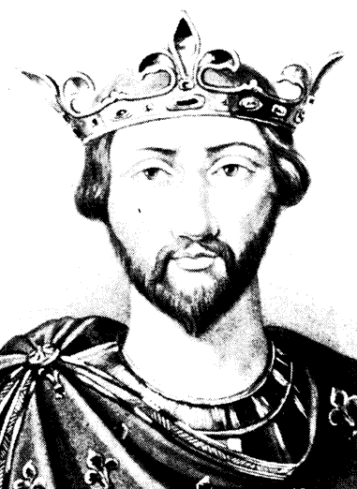
Discover, Develop, Delight
What was the most significant effect of the Black Death?
There are many different results of the Black Death. They can be grouped into sets called factors.
Social
To do with people
Political
To do with running the country
Economic
To do with money
Religious
Military
To do with wars
To do with the church
Notes:
Imagine one day 5 children were absent from school
The next day 10
Then 20
How would you feel?

Slide 4
Discover, Develop, Delight
What was the most significant effect of the Black Death?
Look at the consequence in pairs. What factor does it represent? Feedback to the class. Be prepared to listen to the students and complete the table showing at least 8 results of the disease.
Social
To do with people
Political
To do with running the country
Economic
To do with money
Religious
Military
To do with wars
To do with the church
Social To do with… | Political To do with… | Economic To do with… | Religious To do with… | Military To do with…

Slide 5
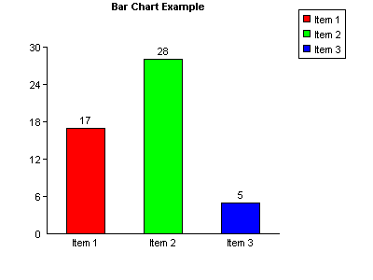
Discover, Develop, Delight
What was the most significant effect of the Black Death?
There are many different results of the Black Death. They can be grouped into sets called factors.
Can you say how many effects there were of each factor? You could display the results in a bar chart.

Slide 6
Discover, Develop, Delight
What was the most significant effect of the Black Death?
Social
To do with people
Political
To do with running the country
Economic
To do with money
Religious
Military
To do with wars
To do with the church
P – Choose the factor which had the biggest impact
The Black Death had the most significant effect on ...
E - Describe the effects of the Black Death on this category.
The Black Death led to.....
A - Explain how this affected peoples' lives and relationships.
The impact of the Black Death meant that …
6 | You will be able to explain why you think this impact was significant.
5 | You will be able to explain how/why the Black Death led to this consequence.
4 | Describe the consequence of a category.
Notes:
Imagine one day 5 children were absent from school
The next day 10
Then 20
How would you feel?

Slide 7
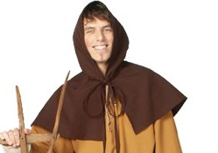
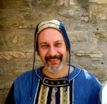
Learning Pit Stop…
Has the Black Death been a good or a bad thing?
How would these men from the 14th century answer?
There are so many more jobs now that plague has killed so many peasants. I should use this as an opportunity to earn more money.
The Peasant
This plague has killed so many of my peasants. If survivors start demanding more in wages, what will they demand next? They might even start challenging my rule! Also I need my Knights to work together, or they might start a civil war!
The Lord
Notes:
Link back to the empathy task from earlier. Do students really understand the differences between a labourer and a lord’s point of view?

Slide 8


Celebrate
What was the most significant effect of the Black Death?
And the star of the lesson is…
WWW = What Went Well Today?
EBI = Even Better If…?
Did you meet your learning objectives?
 | I can come to a personal and supported conclusion on the most significant impact
 | I can explain the impact each effect had on the people
 | I can identify 3 effects of the Black Death

Slide 9
Discover, Develop, Delight
The effects of the Black Death
Listen very carefully to your classmates, can you list any effects of the disease and put it into the correct category?
Social To do with… | Political To do with… | Economic To do with… | Religious To do with… | Military To do with…
Notes:
Photocopying

Slide 10
Learning Pit Stop…
Has the Black Death been a good or a bad thing?
How would these men from the 14th century answer?
There are less peasants to work the land so…
The Peasant
The peasants are demanding more wages so…
The Lord
Notes:
Photocopying for SEN students

